Slide 1
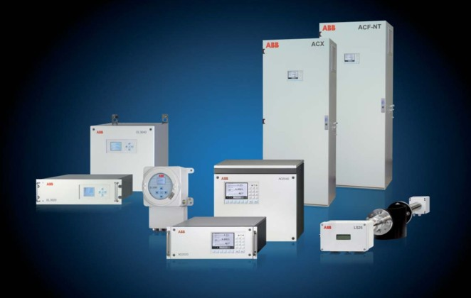
Advanced System Solutions
ACX
Günter Haberzettl, ABB PRU Frankfurt, May 2011

Slide 2
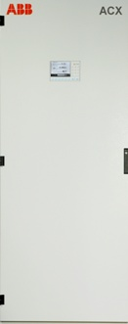
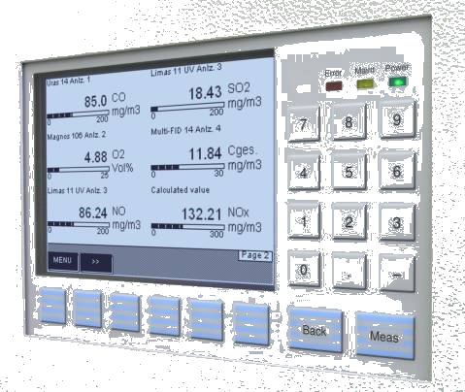
ACX
Advanced CGA System Solution
A complete Analytical Measuring System
for different industrial applications
Monitoring and Operation
via the HMI in the front door
Bulkhead connectors for all mediums available
Interface connectors for Modbus / Profibus
and Ethernet
© ABB
11/08/26 ACX | <number>

Slide 3
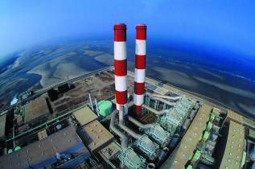
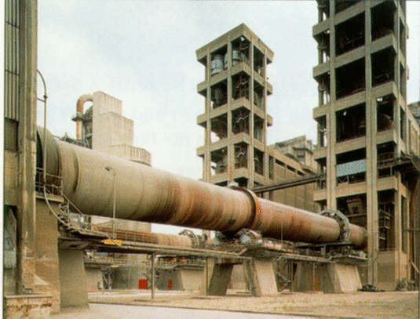
ACX
Applications
Emission monitoring
Combustion of coal, oil and gas
Combustion of waste
Gasification
Cement Plants
Calciner Gas Exit
Wet Kiln Gas Exit
ESP Precipitator (Saftey relevant)
Coal bin and coal mill
Process Monitoring
Optimization
Control
© ABB
11/08/26 ACX | <number>

Slide 4
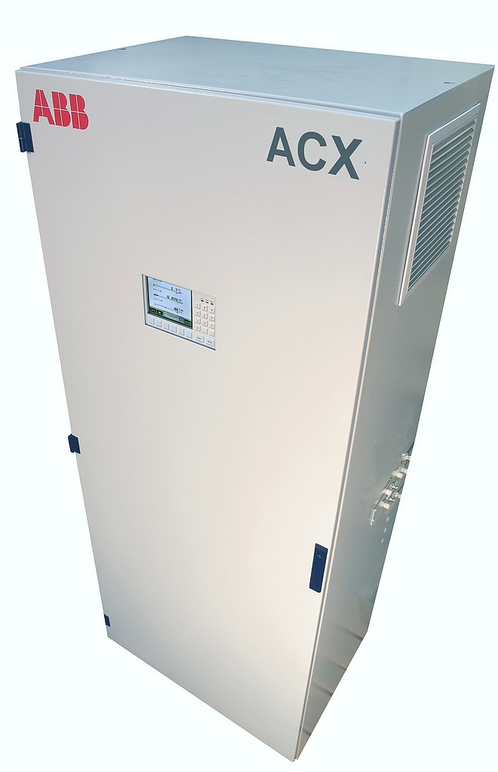
ACX
Concept
Continuously Operating System
Using AO2000 series analyzers
Up to 6 components can be measured simultaneously
Sample Probe & Preparation
Extractive Measurement
Complete product and support of application
Analysis based on ABB – Technology
Best available technology using
IR & UV – Fotometer Uras and Limas
FID – Flame – Ionizations Analyzer MultiFID14
Paramagnetic O₂ – Analyzer Magnos
or O₂ – sensor measurement
© ABB
11/08/26 ACX | <number>

Slide 5

ACX
System Components
Advance Optima Analyzers
  Uras26
  Limas11UV
  Magnos206 / Magnos27
  O₂ - Sensor
  MultiFID14
Sample Conditioning Components
  Probe tubes of the series 40 / 60 / H
  Filter units PFE2 / PFE3
  Heated sample lines TBL01-S and TBL01-C
  SCC-C Cooler
  SCC-F Gas feed unit
  SCC-K NO₂/NO - Converter

AO2040
IR
Error
Maint
Power
7
8
9
4
5
6
1
2
3
0
.
_
Back
Meas


© ABB
11/08/26 ACX | <number>

Slide 6

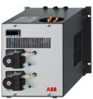

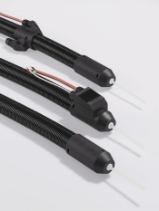
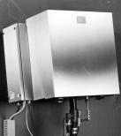


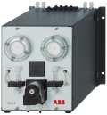

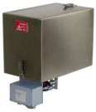
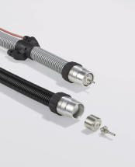



ACX
System Components
Probes
Filters
Lines
Cooler
Feeding
And more...
Probe 40
SCC-C
Cooler
Heated Probe 42
Acid filter
PFE2
TBL01-S
Probe 60
SCC-F
Gas Feed Unit
Probe H
Condensate trap
…..
PFE3
TBL01-S / C
Probe 2 / F
SCC-K
NOx-Converter
© ABB
11/08/26 ACX | <number>

Slide 7
ACX • Example of a System Solution
Exhaust
Uras26
P
O2
CO, SO2
O2
CO, SO2
NO
NO
Condensate trap
Ambient
air
NO2-/NO-
Converter
SCC-C
SCC-F
Acid filter
Probe with
filter unit
Heated Sample Gas Line
Dosing
Condensate
© ABB
11/08/26 ACX | <number>

Slide 8
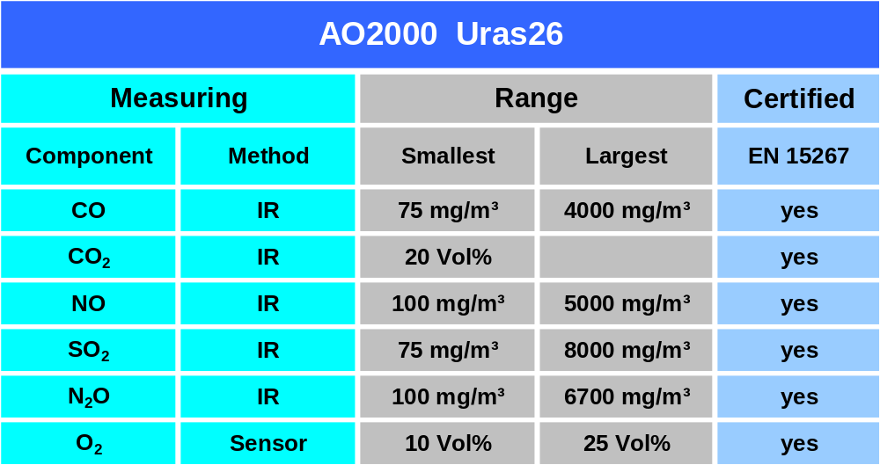
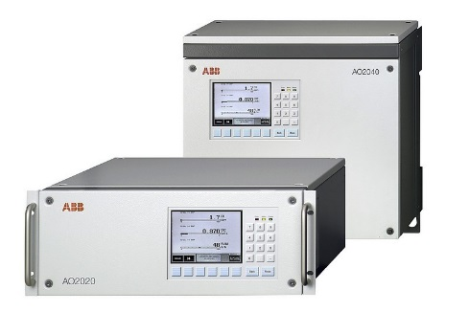
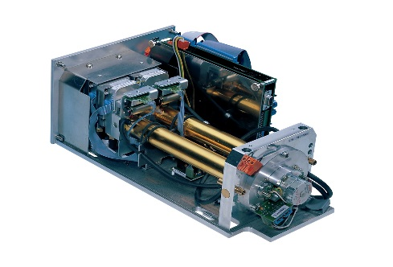
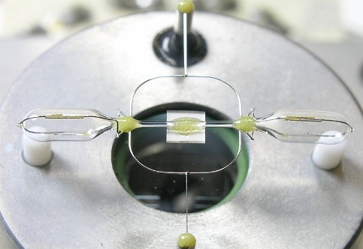
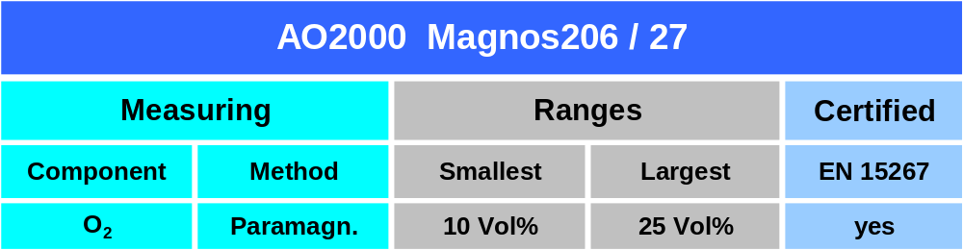
AO2000 Series Analyzers
Combination of components and ranges depends from the application
© ABB
11/08/26 ACX | <number>

Slide 9
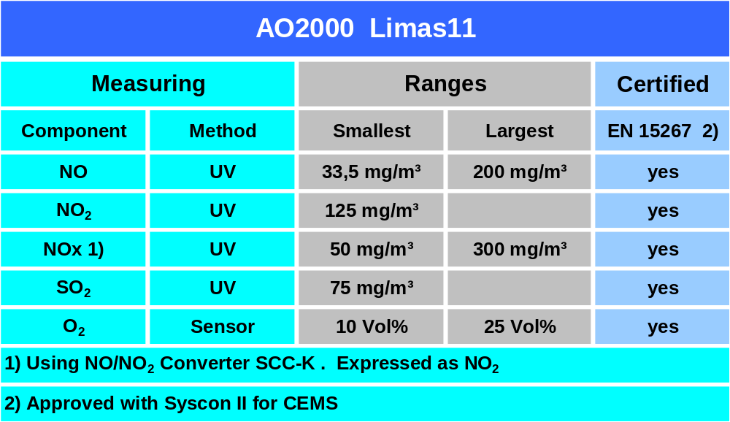
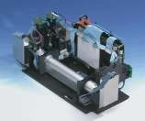
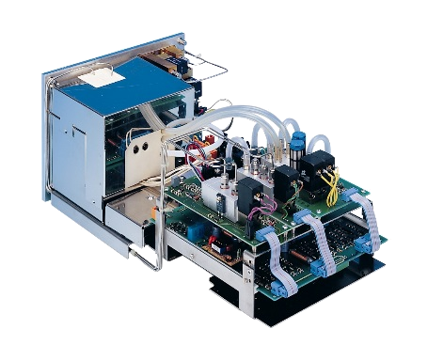
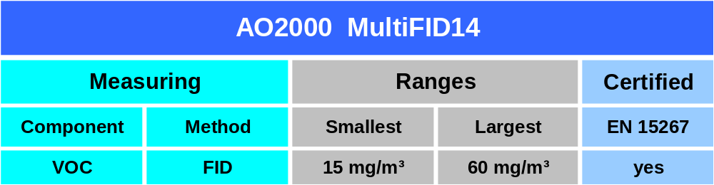
AO2000 Series Analyzers
Combination of components and ranges depends from the application
© ABB
11/08/26 ACX | <number>

Slide 10
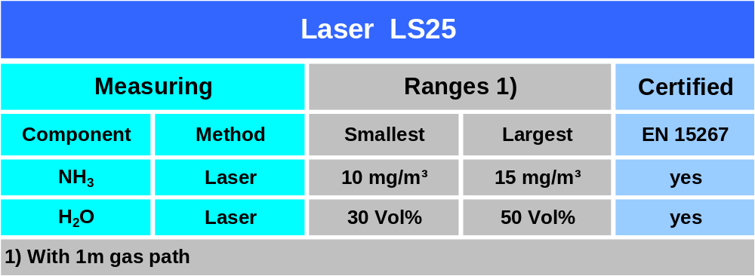
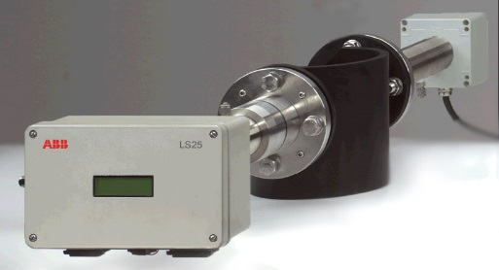
Laser Analyzer Module LS25
Easy Integration into ACX
Single – line spectroscopy
Adujstment of the measuring ranges within the
physically ranges
Optical path length 0,5 – 6,0 m
Using AO2000 platform
  Compatible with all AO2000 modules
© ABB
11/08/26 ACX | <number>

Slide 11
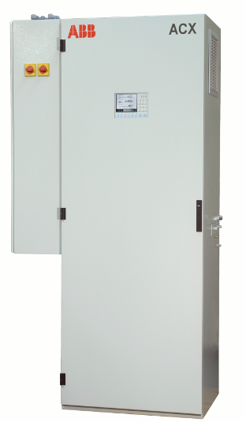
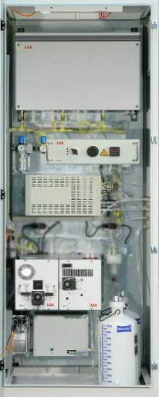
ACX
Exterior and interior views
© ABB
11/08/26 ACX | <number>

Slide 12
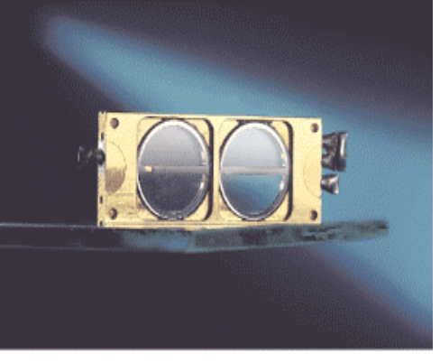
ACX
Analyzer adjustment
Auto calibration is standard
  Uras26 and Limas11UV with
  calibration cells.
  No test gas bottles required
  Magnos206 and O₂ - Sensor
  Single - point calibration with ambient air
  Magnos27 and MultiFID14 via streaming gas flow
© ABB
11/08/26 ACX | <number>

Slide 13
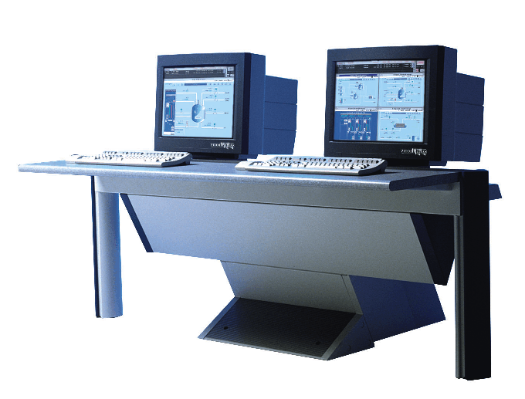
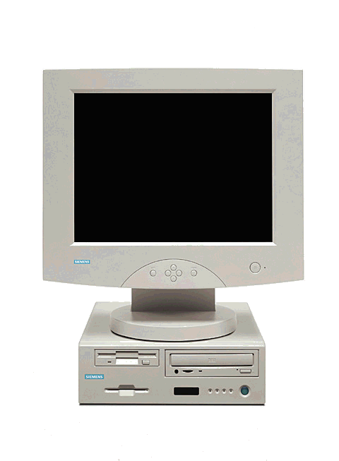
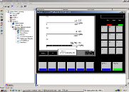





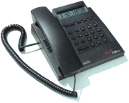
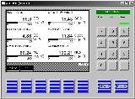

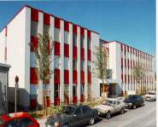
ACX
Control & Maintenance
Maintenance
Control
Diagnosis
Datalogging
Service
Updating
Analyze^{IT} Explorer
QAL3 Quality
Trigger
Values
Status
I/O‘s
AO
OPC-Server
Ethernet TCP/IP
Modem /
ISDN-Router
Modbus
Profibus
Router
Remote
Maintenance
  Analog ( Output / Input )
  Digital ( Output / Input )
© ABB
11/08/26 ACX | <number>

Slide 14
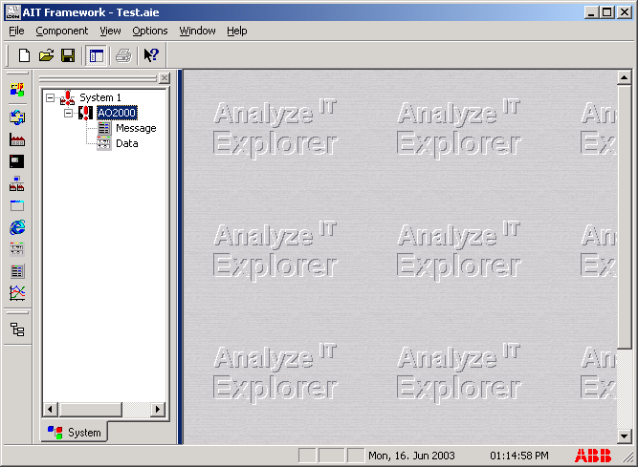
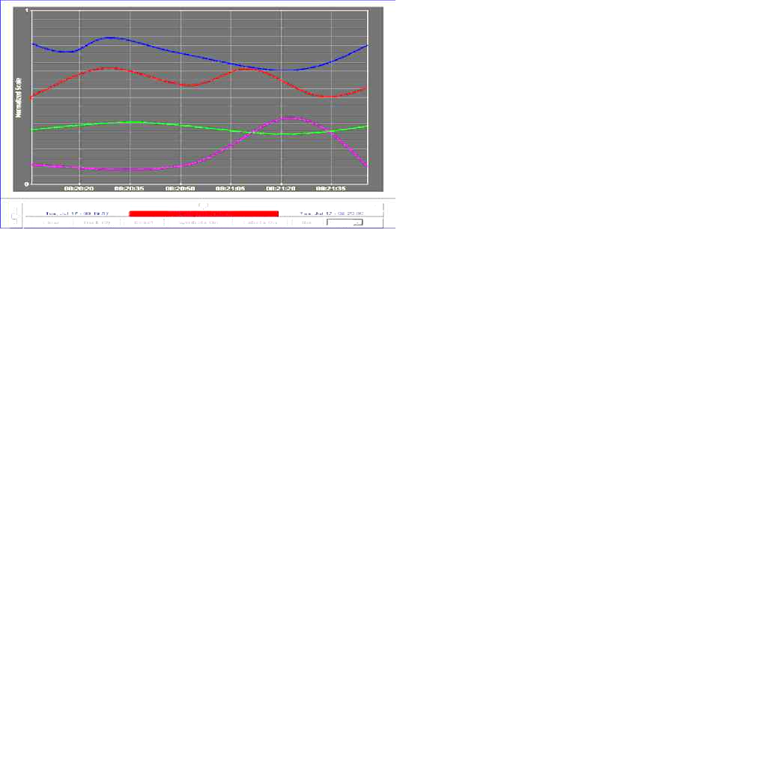
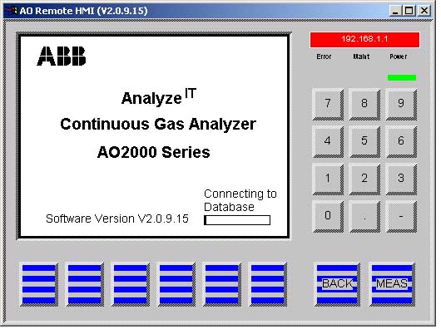
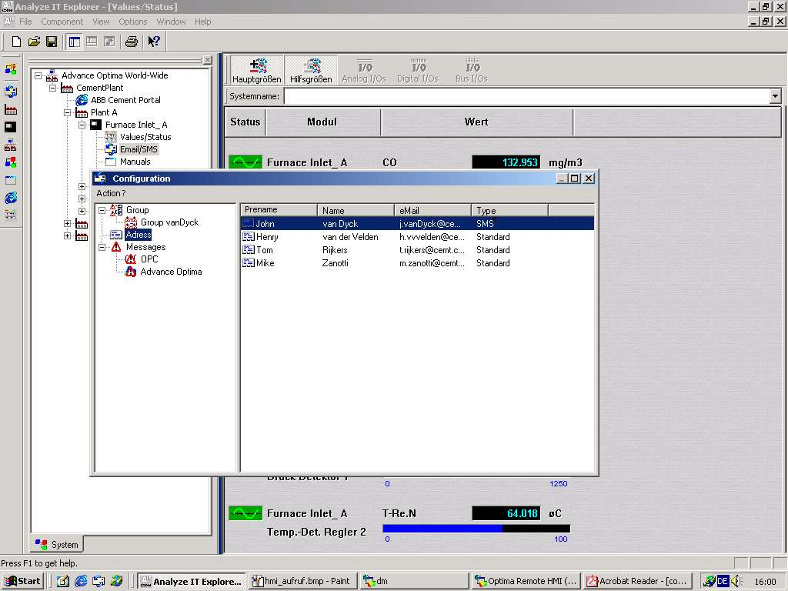
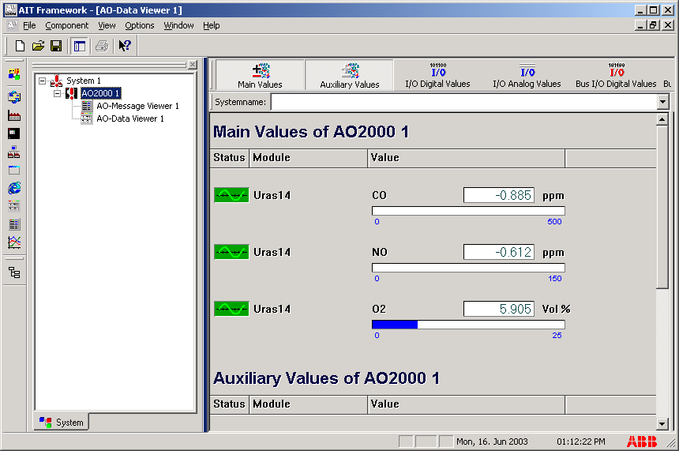
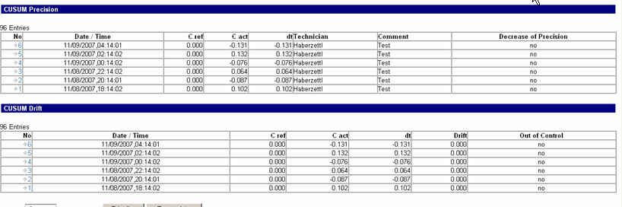
Analyze^{IT} Explorer
Maintenance support & Quality monitoring
  Continuously quality monitoring according to EN 14181 / QAL3
  Logbook functionality
  Fully automated for an AMS equipped with AO2000 analyzers
© ABB
11/08/26 ACX | <number>

Slide 15
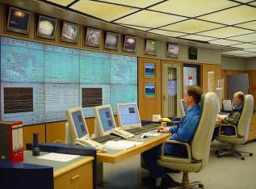



ACX
Profitability – Save money and time
Longest maintenance intervals
Reduction of maintenance efforts
Auto-calibration with adjustment cells
Modern serial communication
Ethernet, Profibus, Modbus
Saves cabling and engineering costs
connecting to your DCS or DAHS for CEM reporting
Remote monitoring
Unattended operation through remote monitoring via standard Ethernet and PC
Cost reduction for routine maintenance
Ethernet
© ABB
11/08/26 ACX | <number>

Slide 16
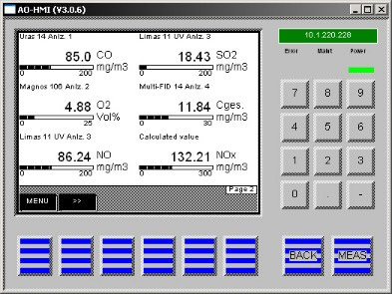
ACX
Flexibility and Smartness
Easy changing of measuring ranges
During the liftetime new measuring
ranges might be required
Function block programming
Easy adaption of back-purge cycles for probes
Adding of external signals
Control
HMI in local languages (latin letters)
© ABB
11/08/26 ACX | <number>

Slide 17
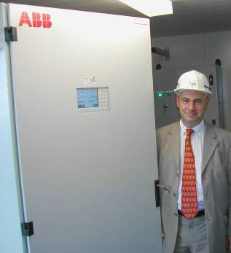
ACX
Reliability
High availability
Proven analyzers and components
Self monitoring
Clear text warnings and alarms in case
of a malfunction before the system fails
Spare Parts
24 h availability of spare parts
© ABB
11/08/26 ACX | <number>

Slide 18
ACX
Reliability
Ready for operation
All you need is …
  Electrial power supply
Maintenance costs
Up to 50% reduced maintenance costs
by 6 months certified maintenance interval
compared to competitor systems
Certified Service
More than 60 manufacturer trained and certified
service engineers world-wide
© ABB
11/08/26 ACX | <number>

Slide 19


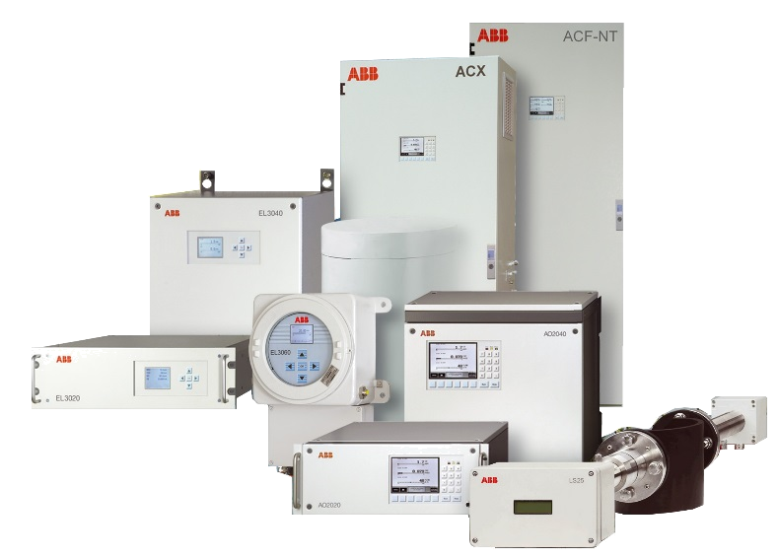
The Added Value
What you can expect from a market leader
Click on the message and learn more about the topics behind
Best choice of analyzers tailored to your needs
Certified support
wherever you are
Long-term security in your investment
Unrivalled
options for
connectivity
Most powerful software solutions
Unique time
and cost saving
calibration concepts
Assured quality through independent certification

Slide 21
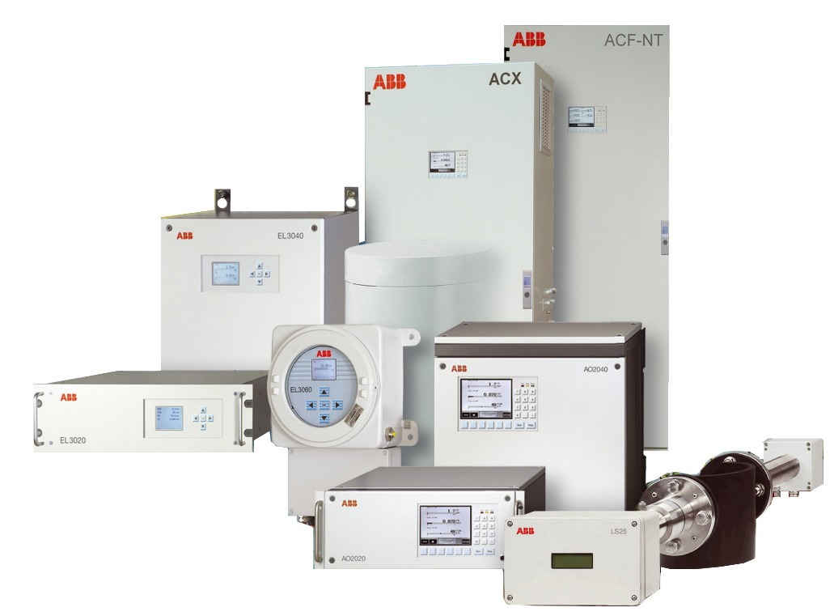
Best choice of analyzers tailored to your needs
What does it mean?
Modular and extendable, tailored to your needs
Lots of measuring principles under one roof
Common, simple Human Machine Interface
Reduced sets of spare parts
Reduced need for training
Multiple protection and installation methods

Slide 22
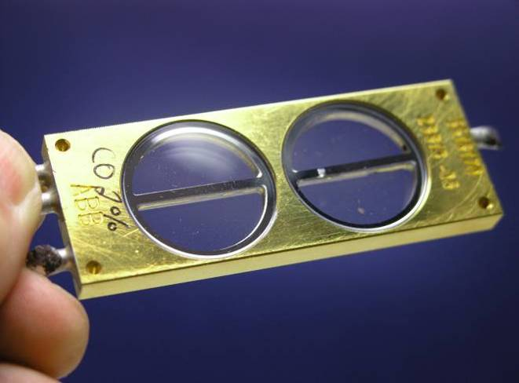
Unique time and cost saving calibration concepts
What does it mean?
Calibration cells for true test gas without bottles
Single point calibration with simple reference gas
High intrinsic stability

Slide 23

Unrivalled options for connectivity
What does it mean?
Access to the Ethernet world
Industry standards Modbus and Profibus
Integrated Web server
Automation standard interface OPC
Integration of process data
Ethernet

Slide 24
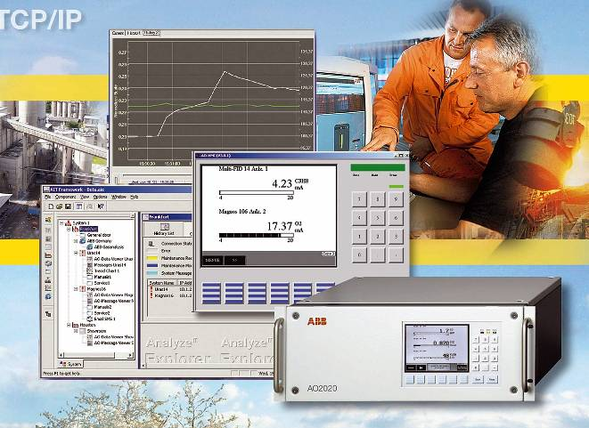
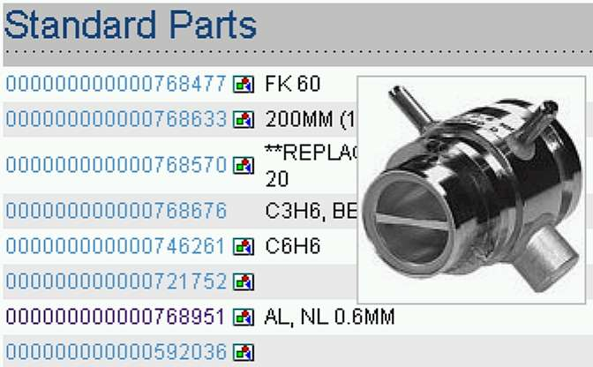
Most powerful software solutions
What does it mean?
Integrated PLC
Full remote operation
Advanced service and configuration tools
Visual spare parts catalog
Built-in web server for quality control
Explore your analyzers plant-wide

Slide 25
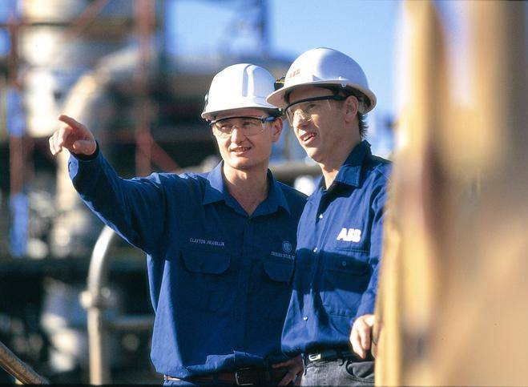
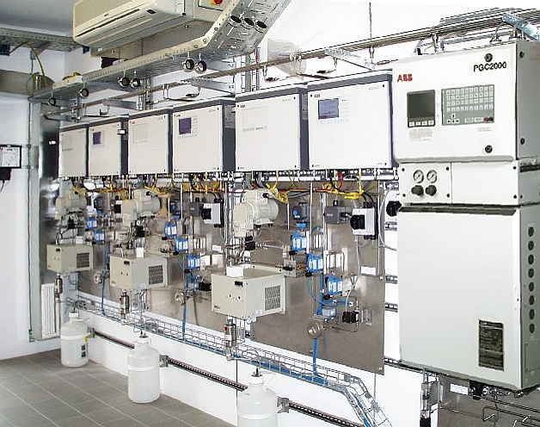
Certified support wherever you are
What does it mean?
Manufacturer certified service engineers
In-depth local competence
Application competence
Web based analyzer data for Service
Latest product information online
Knowledge-based analyzer configuration

Slide 26
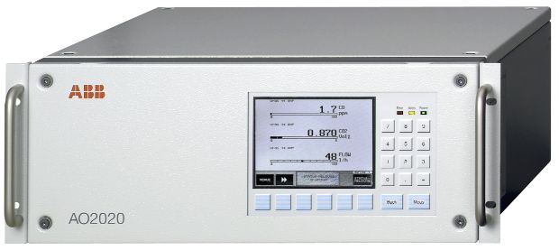
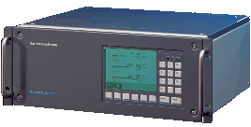
Long-term security in your investment
What does it mean?
Comprehensive Life Cycle Policy
Long-term availability of spares
Long-term extendability
Outstanding upgradeability
2009
1997

Slide 27






Assured quality through independent certification
What does it mean?
CEMS certificates
Hazardous area certificates
Metrological approvals certificates
Electrical safety certificates
Quality management certificates
Factory audits

